Slide 1
AHC - Academy

Slide 2
C# in depth

Slide 3
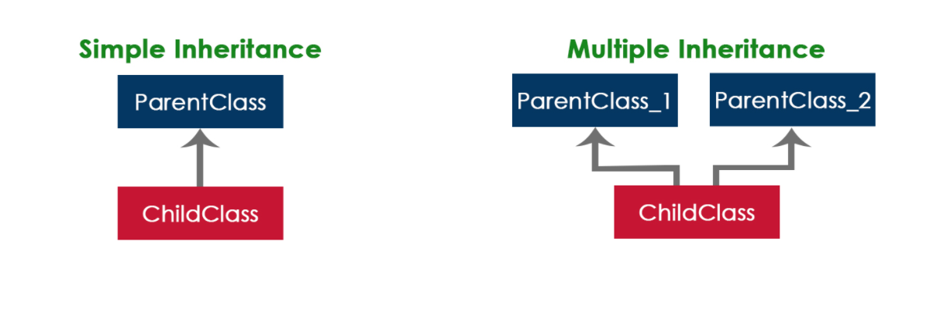
Interfaces
In the human world, a contract between the two or more humans binds them to act as per the contract. In the same way, an interface includes the declarations of related functionalities. The entities that implement the interface must provide the implementation of declared functionalities.

Slide 4
Rules of interfaces
Use interface keyword to implement it
Name should start with I
An interface cannot be instantiated
It cannot contain fields
All the members are public by default.
Cannot include private, protected, or internal members.
In C# 8.0, you can define an implementation for members declared in an interface.

Slide 5
Benefits of interfaces
Easy code maintenance
Unit testing
Extensibility

Slide 6
Demo
Interfaces

Slide 7
Exercise
Interfaces
Create a console app.
Create an interface called IShape.
Create an interface method called Area.
Create a class called Triangle and calculate the area of the triangle by implementing the Area method from the Ishape interface.
Instantiate a Triangle object and sent out the triangle Area result to the console.writeline.

Slide 8
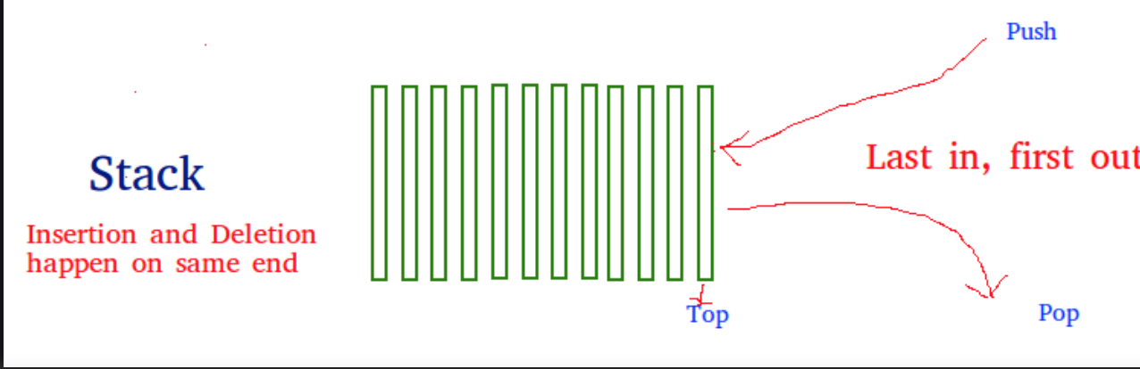
Data Structures - Stack
LIFO(Last In First Out) or FILO(First In Last Out).
Example: Plates stacked over one another in a restaurant.

Slide 9
Application of Stacks
Balancing of symbols
Infix to Postfix /Prefix conversion
Redo-undo features at many places like editors, photoshop.
Forward and backward feature in web browsers
Used in many algorithms like Tower of Hanoi, tree traversals, stock span problem, histogram problem.
Backtracking is one of the algorithm designing techniques. Some examples of backtracking are the Knight-Tour problem, N-Queen problem, find your way through a maze, and game-like chess or checkers.
In Graph Algorithms like Topological Sorting and Strongly Connected Components
In Memory management, any modern computer uses a stack as the primary management for a running purpose. Each program that is running in a computer system has its own memory allocations
String reversal.

Slide 10
Demo
Data Structures - Stack

Slide 11
Exercise
Stack
Design a Data Structure SpecialStack that supports all the stack operations like push(), pop(), isEmpty(), isFull() and an additional operation getMin() which should return minimum element from the SpecialStack. All these operations of SpecialStack must be O(1). To implement SpecialStack, you should only use standard Stack data structure and no other data structure like arrays, list, . etc.
Consider the following SpecialStack:
16 --> TOP
15
29
19
18
When getMin() is called it should return 15, which is the minimum element in the current stack. If we do pop two times on stack, the stack becomes:
29 --> TOP
19
18
When getMin() is called, it should return 18 which is the minimum in the current stack.

Slide 12
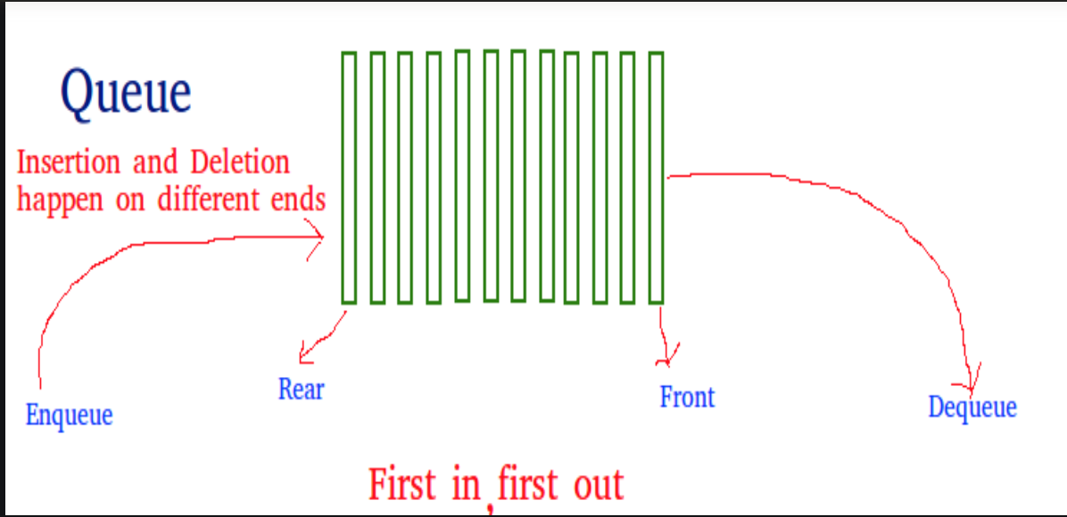
Data Structures - Queue
The order is First In First Out (FIFO).
Example: A line in a bank, where the consumer that came first is served first.

Slide 13
Application of Queues
When a resource is shared among multiple consumers. Examples include CPU scheduling, Disk Scheduling.
When data is transferred asynchronously (data not necessarily received at same rate as sent) between two processes. Examples include IO Buffers, pipes, file IO, etc.

Slide 14
Demo
Data Structures - Queue

Slide 15
Exercise
Queue
Implement a Queue using an Array. Queries in the Queue are of the following type: (i) 1 x (a query of this type means pushing 'x' into the queue) (ii) 2 (a query of this type means to pop element from queue and print the poped element)
Example:
Input:
Q = 5
Queries = 1 2 1 3 2 1 4 2
Output: 2 3
Explanation: In the first test case for query
1 2 the queue will be {2}
1 3 the queue will be {2 3}
2 popped element will be 2 the queue will be {3}
1 4 the queue will be {3 4} 2 popped element will be 3
Your Task : You are required to complete the two methods push() which take one argument an integer 'x' to be pushed into the queue and pop() which returns a integer poped out from othe queue. If the queue is empty, it should return -1 on a pop operation.
Expected Time Complexity: O(1) for both push() and pop(). Expected Auxiliary Space: O(1) for both push() and pop().
Constraints: 1 ≤ Q ≤ 10⁵ 1 ≤ x ≤ 10⁵

Slide 16
Reflection
Reflection is when managed code can read its own metadata to find assemblies. Essentially, it allows code to inspect other code within the same system.
You can dynamically create an instance of a type and bind that type to an existing object. When you use attributes in your code, reflection gives you access as it provides objects of Type that describe modules, assemblies, and types.

Slide 17
Benefits of reflection
Reutilize other dlls
You can access attributes from the class
Get the type from an existing object and access its properties

Slide 18
Demo
Reflection

Slide 19
Exercise
Reflection
Create a class library app.
Create a class with a method called AddNumber with two integer parameters.
Build the solution to get the dll assembly file.
Create a console app.
In the Main method use the Assembly.LoadFile to load the dll you created on previous steps.
Call the GetType of the assembly.
Use the GetMethod("AddNumber") to get the properties of the AddNumber method you created on step 2.
Call the FullName and sent the output to the console.writeline.

